Slide 1
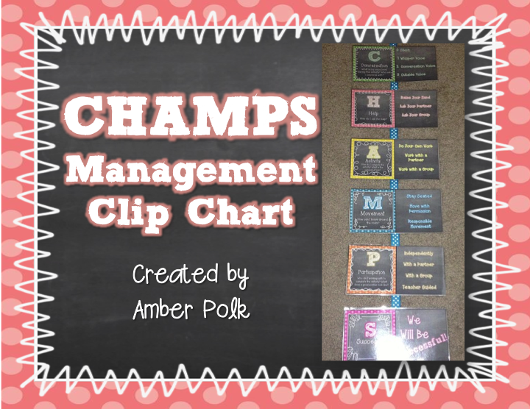

Slide 10
Conversation
What is my voice level during this activity?

Slide 11
Help
How do I ask for help?

